Slide 1

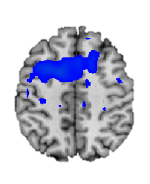
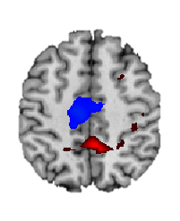
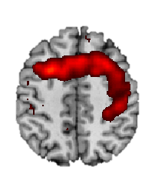


CONFLICT-RELATED ACTIVATION OF POSTERIOR MEDIAL FRONTAL CORTEX IN PEDIATRIC READING DISORDER
Katie Davis, Amy Margolis, Lauren Thomas, Marilyn Cyr, Rachel Marsh
Division of Child and Adolescent Psychiatry in the Department of Psychiatry, Columbia University
OBJECTIVE
RESULTS
CONCLUSIONS
Altered activation of posterior medial frontal cortex (pmFC) during conflict processing is common in pediatric anxiety disorders, and the degree of activation correlates with anxiety symptoms (Fitzgerald, 2013).
Given the common occurrence of anxiety in learning disorders, we assessed the functioning of frontal cortices during the resolution of cognitive conflict in children with reading disorder.
Significant group differences in conflict related activations were observed in left pMFC, driven by greater activations in reading disordered compared to healthy participants. Left pMFC activation was positively associated with poor reading (p<0.025) and anxiety (P<0.001).
When engaging the cognitive control necessary to resolve conflict, children with reading disability displayed excessive activation of pmFC.
These findings are consistent with findings from children with anxiety.
Excessive pmFC-based reactivity may contribute to self-regulatory difficulties transdiagnostically across learning and anxiety problems in children.
These functional disturbances may represent a shared neurobiological substrate underlying both reading and anxiety disorders.
METHODS
pmFC
pmFC
pmFC
fMRI scans were acquired from children with reading disorder (n=14) and age-matched healthy controls (n=19) during their performance of the Simon Spatial Incompatibility task.
Simon Task
Participants pressed a button corresponding to the side of the screen on which an arrow appeared. The task required ignoring a task-irrelevant stimulus feature (the side of the screen on which an arrow appears) when it conflicts with a more task-relevant one (the direction arrow points). Participants completed 3 runs of 55 stimuli with equal numbers of congruent/incongruent stimuli.
HC-RD
HC
RD
REFERENCES
Figure 1. Group Differences in Brain Activity Associated with Conflict. Significant group differences were detected in pmFC that derived from greater activation of this region in the RD compared to TD participants, in response to cI versus cC stimuli.
Fitzgerald, Kate D., Yanni Liu, Emily R. Stern, Robert C. Welsh, Gregory L. Hanna, Christopher S. Monk, K. Luan Phan, and Stephan F. Taylor. “Conflict-Related Hyperactivation of Posterior Medial Frontal Cortex Across the Pediatric Anxiety Disorders.” Journal of the American Academy of Child & Adolescent Psychiatry 0, no. 0 (February 18, 2013). doi:10.1016/j.jaac.2013.02.002.
Horga G, Maia TV, Wang P, Wang Z, Marsh R, Peterson BS. Adaptation to conflict via context-driven anticipatory signals in the dorsomedial prefrontal cortex. J. Neurosci. 2011;31(45):16208-16216.
Reading Impairment Score
A reading impairment score was created by assigning one point for each of the following: (1) each reading measure on which participants scored at or below the 25th percentile, (2) a history of academic difficulty or reading intervention, (3) a prior diagnosis of a reading disorder, and (4) placement in a special education school. A higher reading impairment score indicates worse overall reading proficiency.
Statistical Analyses
Figure 2a. Correlation of pmFC Activation During Resolution of Conflict with Reading Impairment. Activation of left pmFC was positively associated with reading impairment, r=0.392, p=0.024, suggesting that those children who have the most reading impairment activate frontal control regions the most during resolution of conflict.
Figure 2b. Correlation of pmFC Activation During Resolution of Conflict with Anxiety. Activation of left pmFC was positively associated with anxiety, r=0.402, p=0.025, suggesting that those children who have the most anxiety activate frontal control regions the most during resolution of conflict.
Our analyses focused on post-congruent conflict (incongruent compared to congruent stimuli preceded by congruent stimuli) – the contrast associated with the greatest magnitude of activation in fronto-striatal regions in healthy individuals (Horga, 2011).
We assessed group differences in conflict-related activations and associations with reading impairment and anxiety (RCMAS Total Score).
ACKNOWLEDGEMENTS AND FINANCIAL DISCLOSURES
This work is supported by The NVLD Project and The Promise Project at Columbia. All authors report no biomedical financial or potential conflicts of interest.

